Slide 1





Slide 2
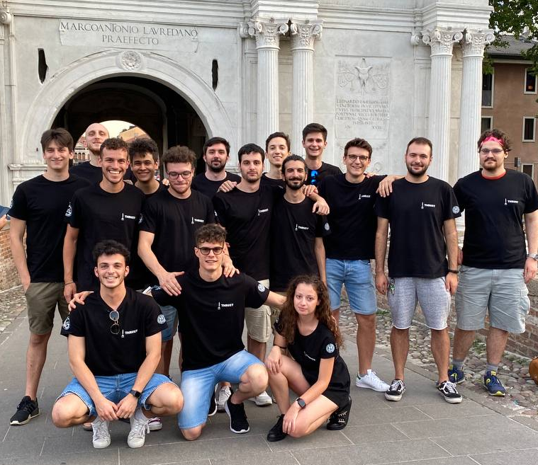
Introduction
Introduzione
THRUST is a student project born at the University of Padova in 2020. Its main goals are to:
Design
Assemble
Test
Launch
A hybrid-propellant sounding rocket.
And all the systems needed for it to work:
Ground Station
Launch pad
Test Facilities
Since 2020 the project has grown really fast: what started
with just 5 people, today counts 60 members,
not only aerospace engineering students,
but students from different departments of the university.

Slide 3
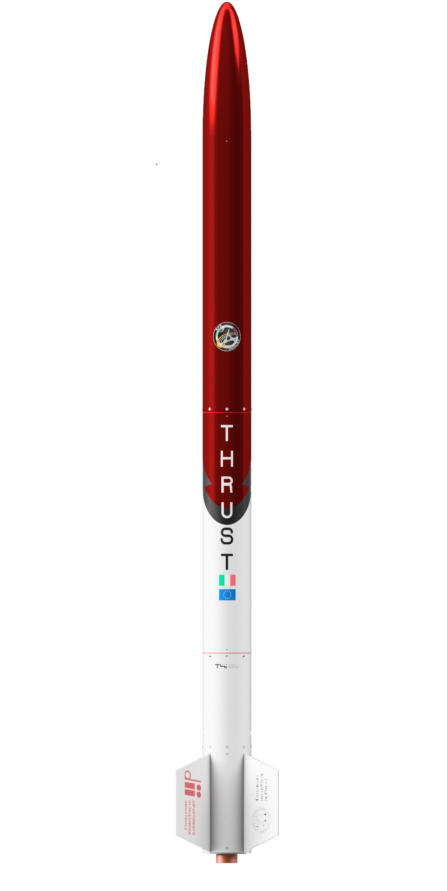

SFR I
SFR I
SFR I is the first technology developed by THRUST.
A M class rocket designed to fly 3 Cansat at a 3 Km height:
Diameter = 150 mm
I_{sp,vac} = 241 s
Mass = 30 kg
Would be the first hybrid sounding rocket designed by students in Italy to fly

Slide 4
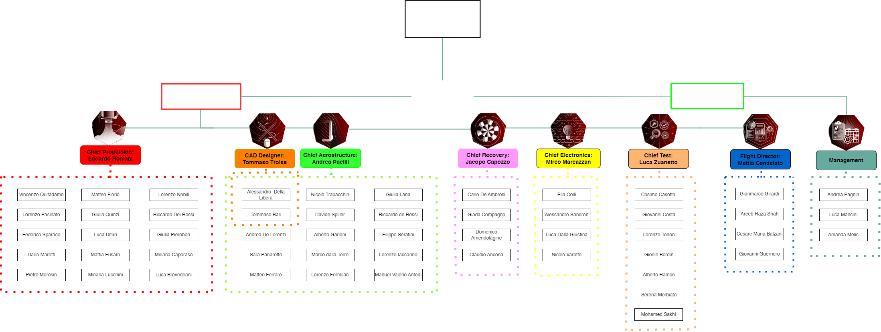
THRUST BOARD

Slide 5
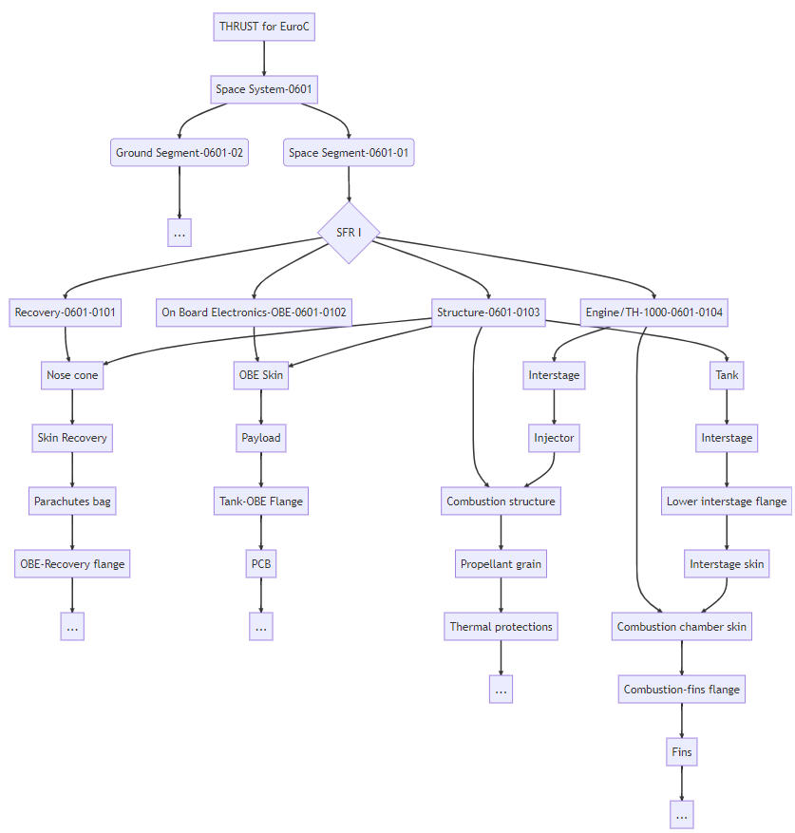
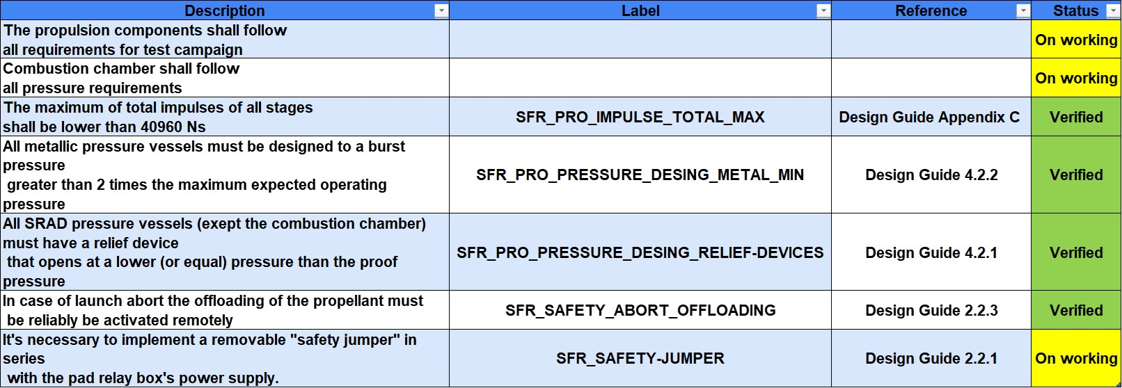


Organization & Tools
Propulsion Requirements

Slide 6
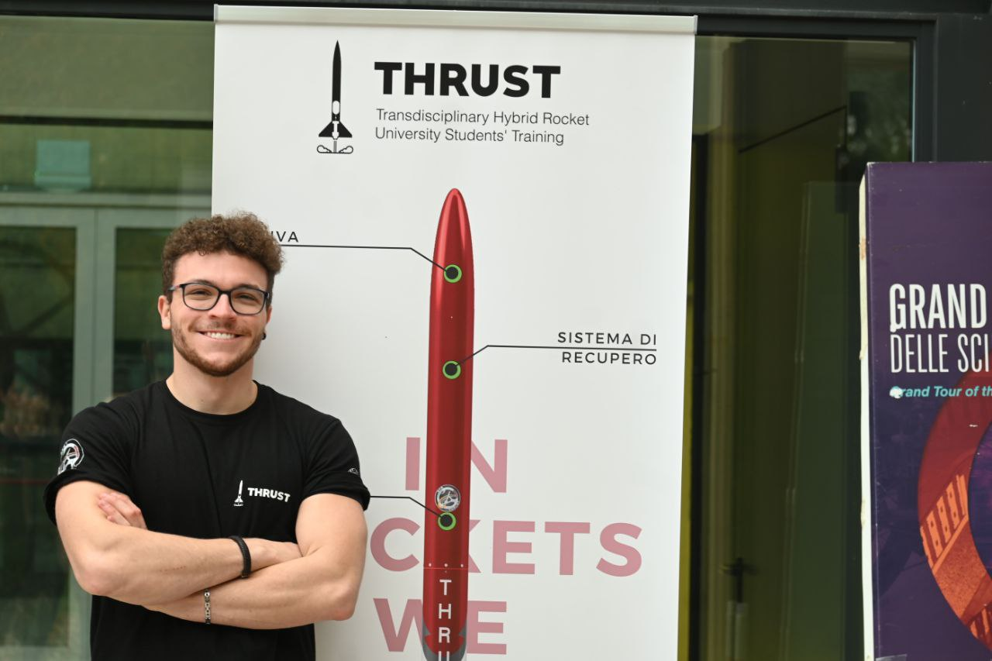
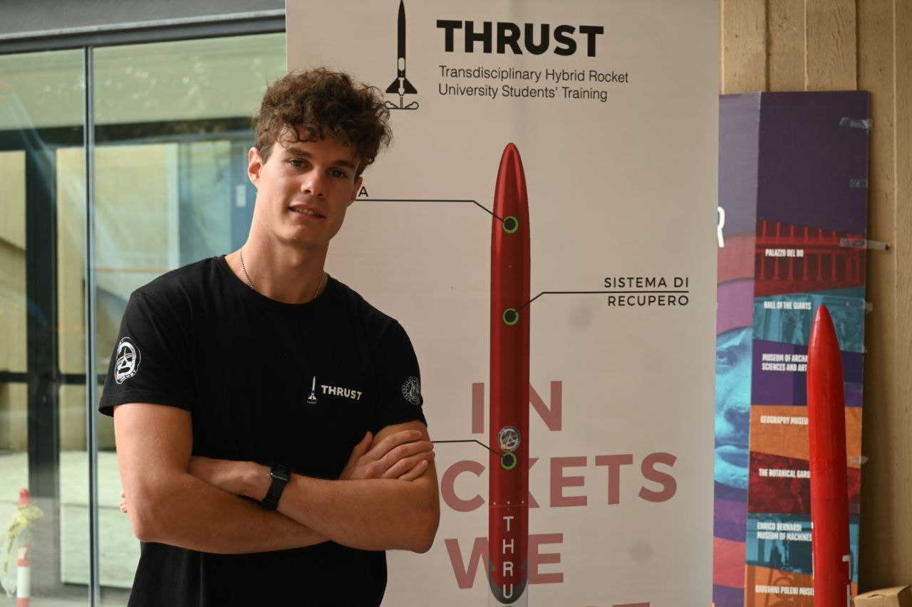
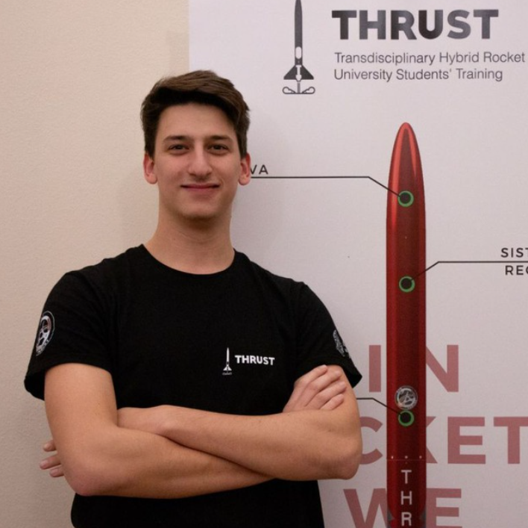
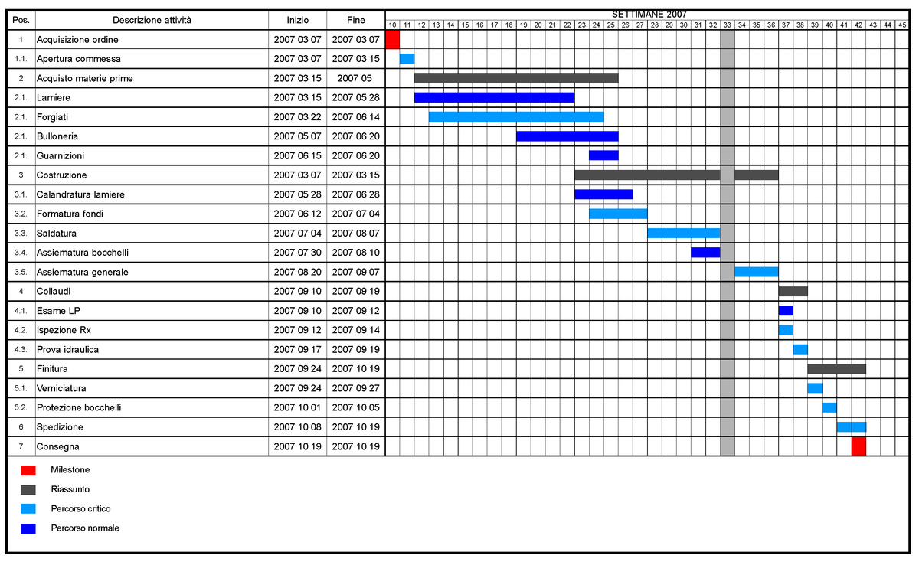
Workflow & Tools
Report
Tools:
Work Package
Reports
Notes
Gantt
Notes
CTO
PM
CFO
Work Package (WP)
Report
Work Package (WP)
Chief
Notes
Work Package (WP)
Report
Member

Slide 7

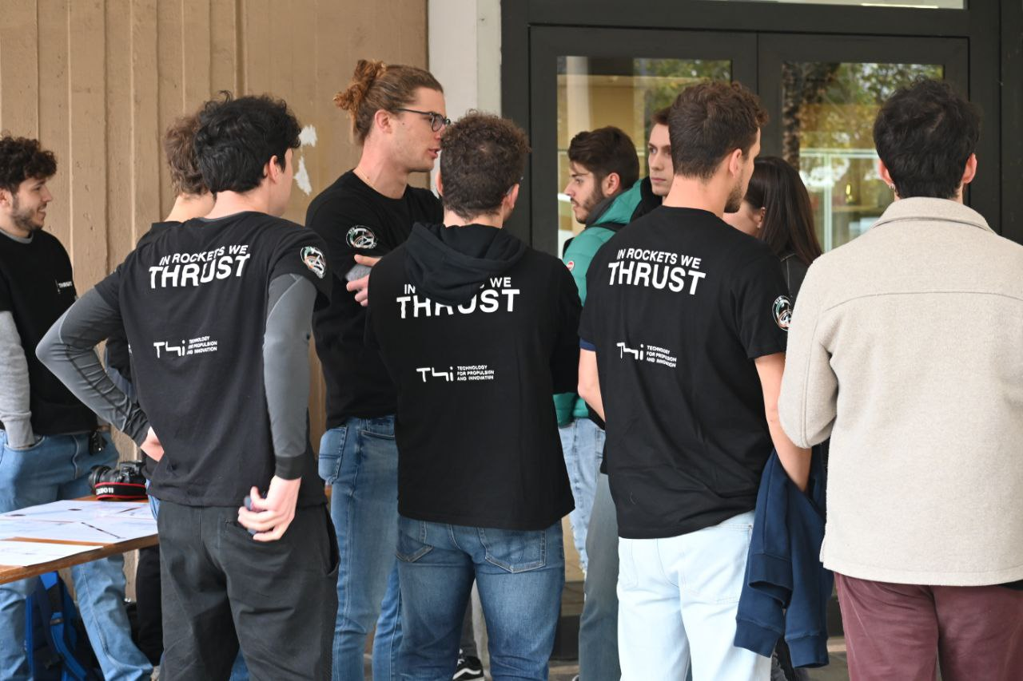

Next Events
Scheduled events:
Meeting with companies organized by the university
Italian rocketry teams meeting, May 2nd 2023
Space Meeting Veneto, Venice May 15-17 2023
EuroC 2024
Many others

Slide 8




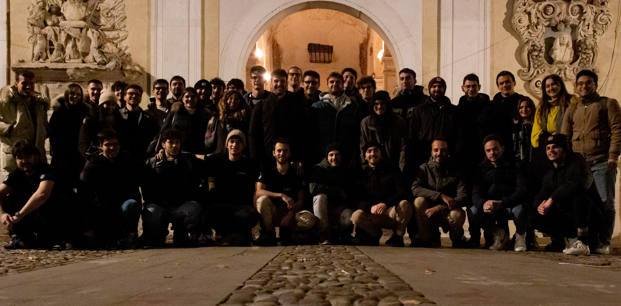
What can we offer?
thrust.team
Ads on our socials and our website
Public events with students
Connections with both national and international space realities
Logo on SFR I
THRUST Student Project
https://thrust-team.it/

Slide 9
«IN ROCKETS WE THRUST»

Slide 10
FIN

